Slide 1
Sales Analysis
The Electronic Shop

Slide 2
CONTENTS
There’s what you’ll find in this Presentation:
Presentation Title. Page (1)
Table of Contents. Page (2)
Total Sales In 2019, Highest Sales Q % From Total Sales and Highest Sales Month % From Total Sales . Page (3)
Insights From Sales Break Down By Month. Pages (4,5,6)
Insights From Sales Break Down By Hour. Page(7)
Sales Analysis by product. Pages (8,9)
States Sales Analysis Insights and recommendations. Page(10)
Thank you. Page (11)

Slide 3
0.33%
13%
Total Sales
Max Quarter Sales%
Max Monthly Sales%
35.4 M

Slide 4
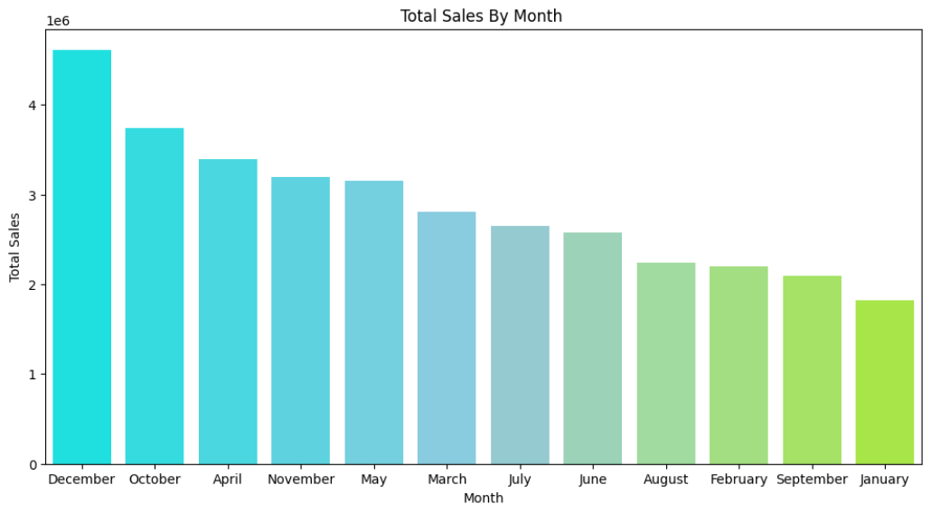
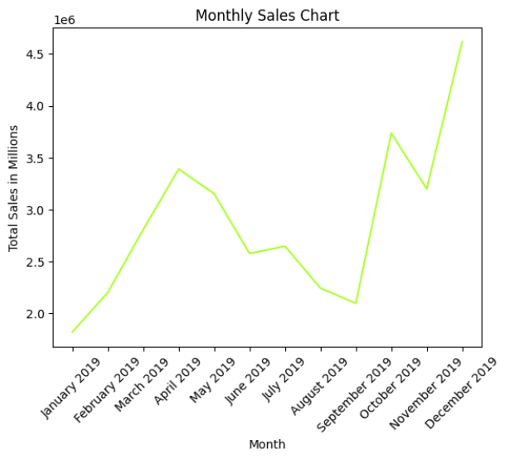
Monthly Sales
It's evident from the graph that the highest sales occur in December and October.
whereas the lowest sales are recorded in January, September, and February.
We'll delve deeper into this analysis when we examine the Sales By Quarter Chart

Slide 5
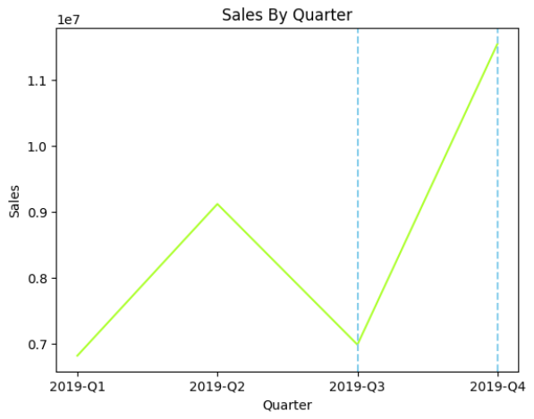
Qaurters Sales
Based on the sales by quarter chart, it is evident that the majority of our sales occur between October and December.
Conversely, there is a significant decline starting from March, with January and February also showing comparatively lower sales volumes.

Slide 6
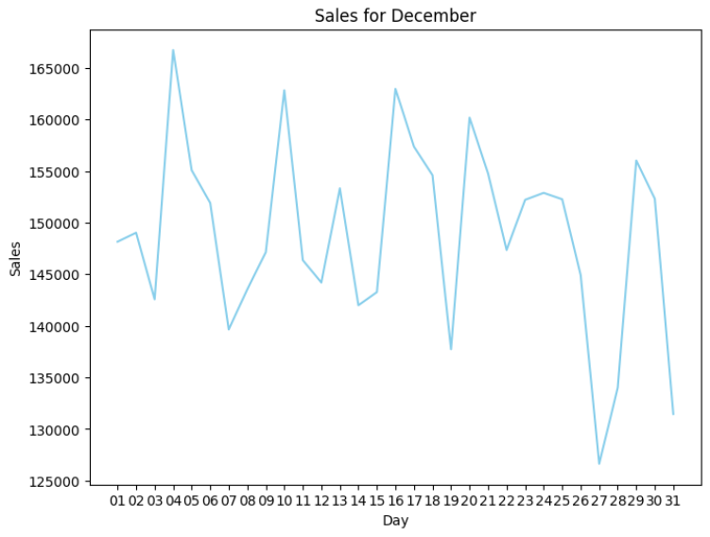
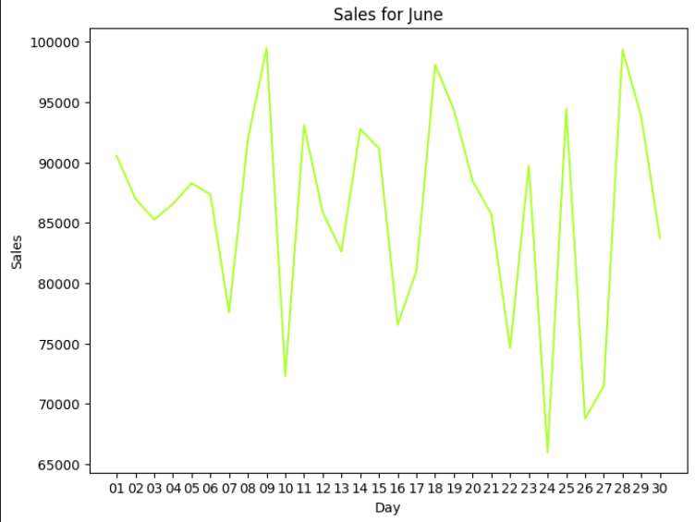
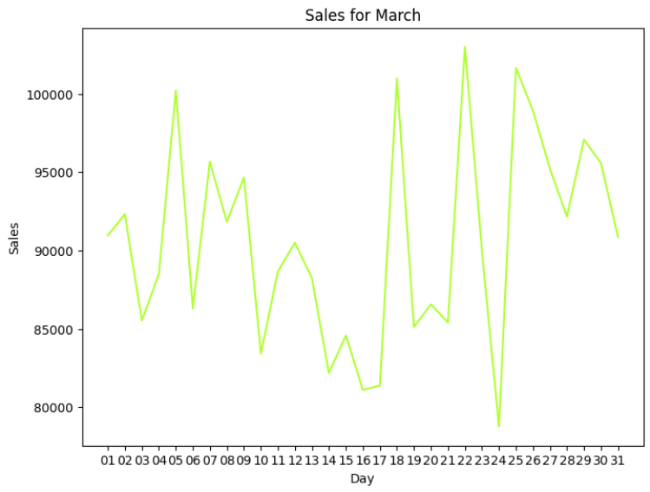
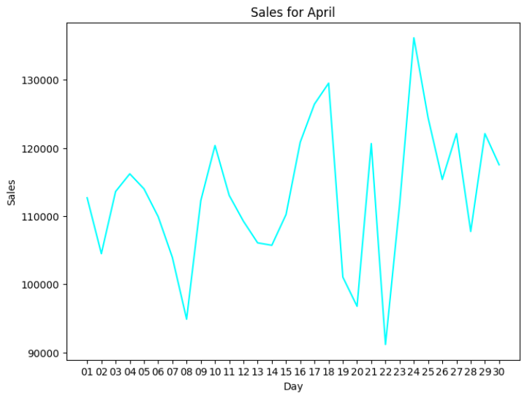
The charts represent the months with the highest sales within each quarter. Upon observation, a recurring pattern emerges: sales typically experience a slight drop from Day 10 to Day 15. My recommendation is to introduce special offers or promotions during this short period to stimulate buyer engagement and enhance sales
Monthly Sales

Slide 7
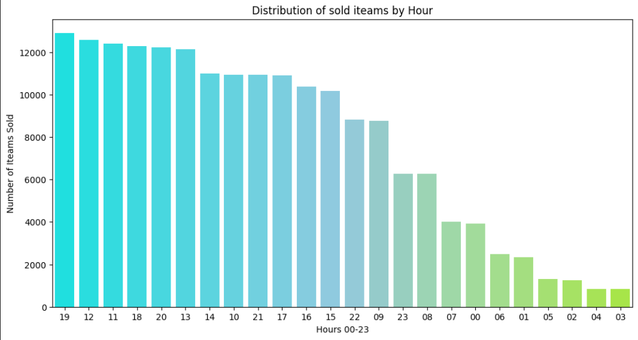
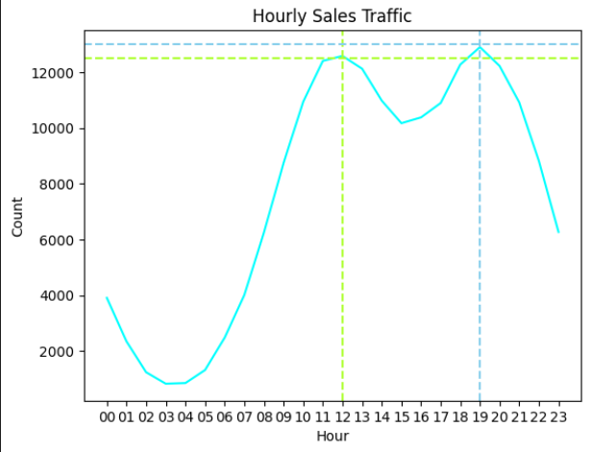
From The Hourly Sales Dis-chart I recommend that we can save the money paid at operating from 12 am to 7pm Since we have Low Traffic on those hours. From The Hourly Sales Traffic Chart I do recommend that the Advertising screen and flyers Best Timing is at around 12 pm or 7pm
Hourly Sales

Slide 8
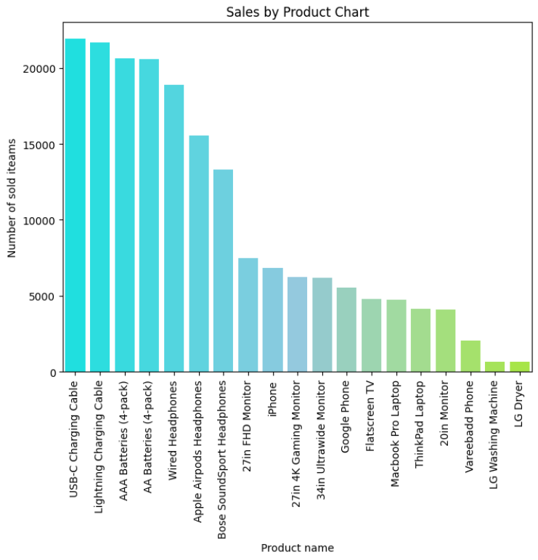
Products Sales
From the bar chart I do highly recommend that our stocks should always have the first 7 products in the list.
Stock from product should be 10% from the overall sales of each product.
example every stock should have at least 200 USB-C Charging Cable since and so on.

Slide 9
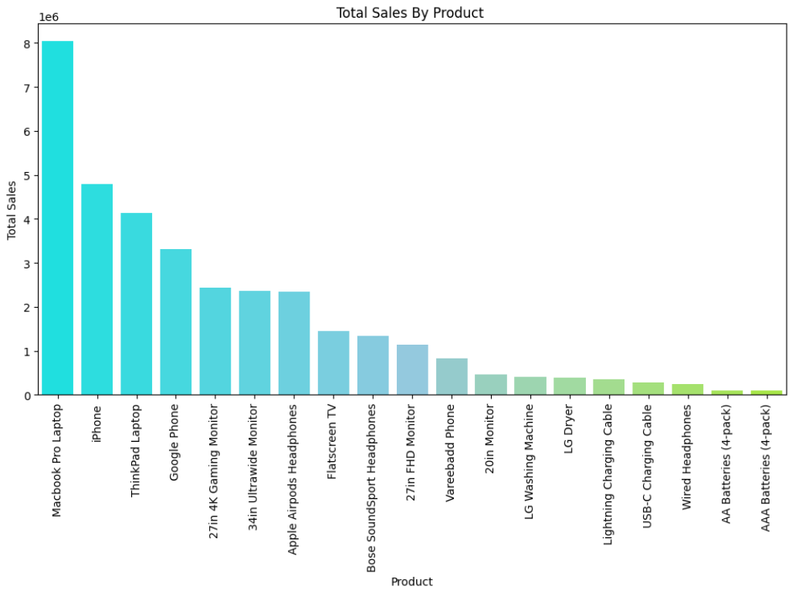
Products Sales
From the Chart It’s crystal clear that Mac-book Pro Laptop is our top product.
Apple products in General Sale More.
I Recommend increasing the Varity of apple products at the store.
Apple Product packages is an Idea that we should test.

Slide 10
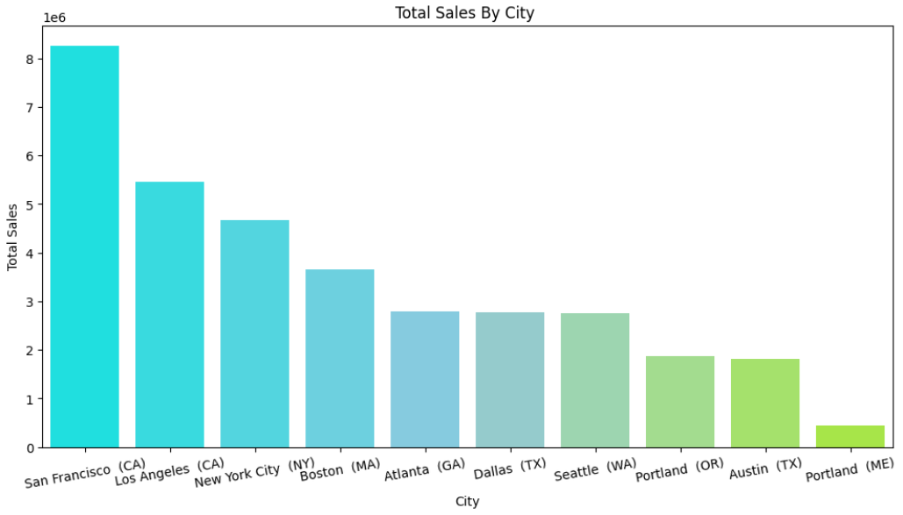
Sales By City
San Francisco is our star for this year.
Sales at Portland is very low weather we clos this shop and save the opertion cost or market our salves in this city.
We might consider oppening in other states which will most propably increase our sales margin.

Slide 11

Thank You
By : Mohab Radwan

